Slide 1
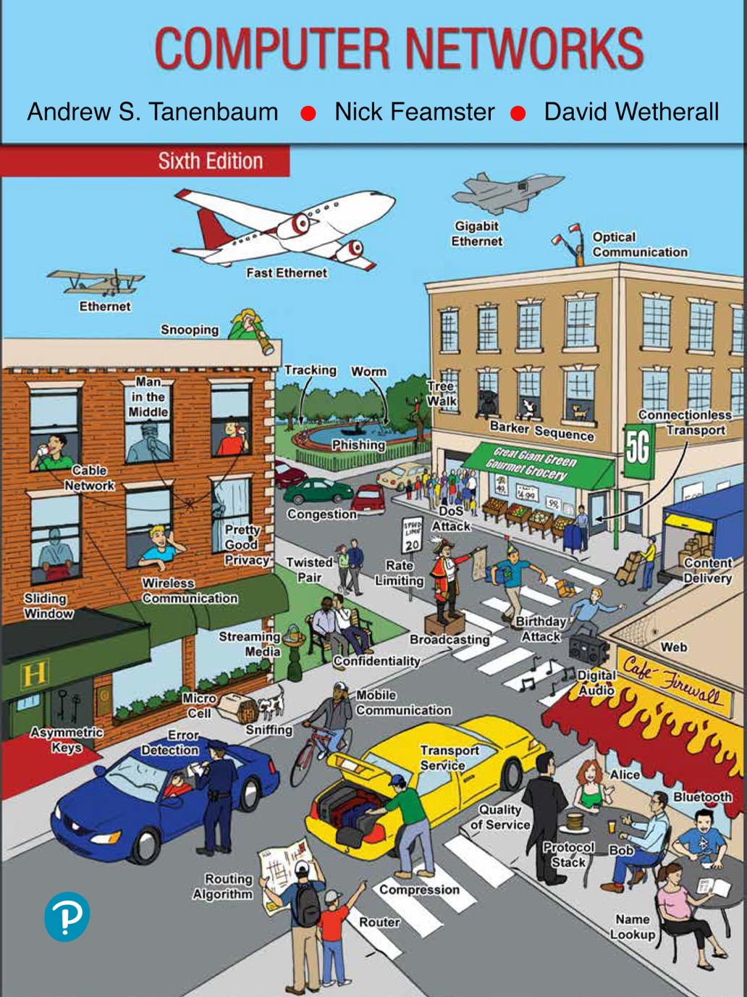
Chapter 5
The Network Layer

Slide 2
Network Layer Design Issues
Store-and-forward packet switching
Services provided to the transport layer
Implementation of connectionless service
Implementation of connection-oriented service
Comparison of virtual-circuit and datagram networks

Slide 3
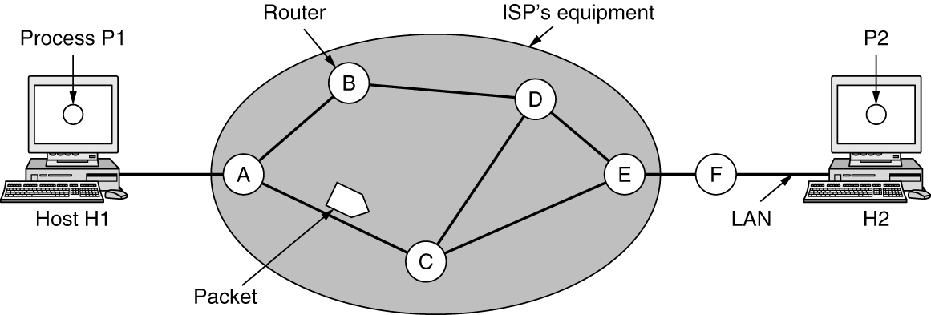
Store-and-Forward Packet Switching
A host with a packet to send transmits it to the nearest router.
The packet is stored there until it has fully arrived, and the link has finished its processing by verifying the checksum.
Then it is forwarded to the next router along the path until it reaches the destination host, where it is delivered.
This mechanism is store-and-forward packet switching
The environment of the network layer protocols

Slide 4
Services Provided to the Transport Layer
Services independent of router technology
Transport layer shielded from number, type, topology of routers
Network addresses available to transport layer use uniform numbering plan
Even across LANs and WANs

Slide 5
Battle between two warring factions
One camp (represented by the Internet community) argues that the routers’ job is moving packets around and nothing else. This viewpoint leads to the conclusion that the network service should be connectionless.
The other camp (represented by the telephone companies) argues that the network should provide a reliable, connection-oriented service.

Slide 6
Connectionless VS Connection Oriented
Connectionless service:
packets are injected into the network individually
Routed independently of each other
No advance setup is needed
The packets are frequently called datagrams
The network is called a datagram network
Connection-oriented service:
A path is established from the source router to destination router. This connection is called a VC (Virtual Circuit)
The network is called a virtual-circuit network

Slide 7
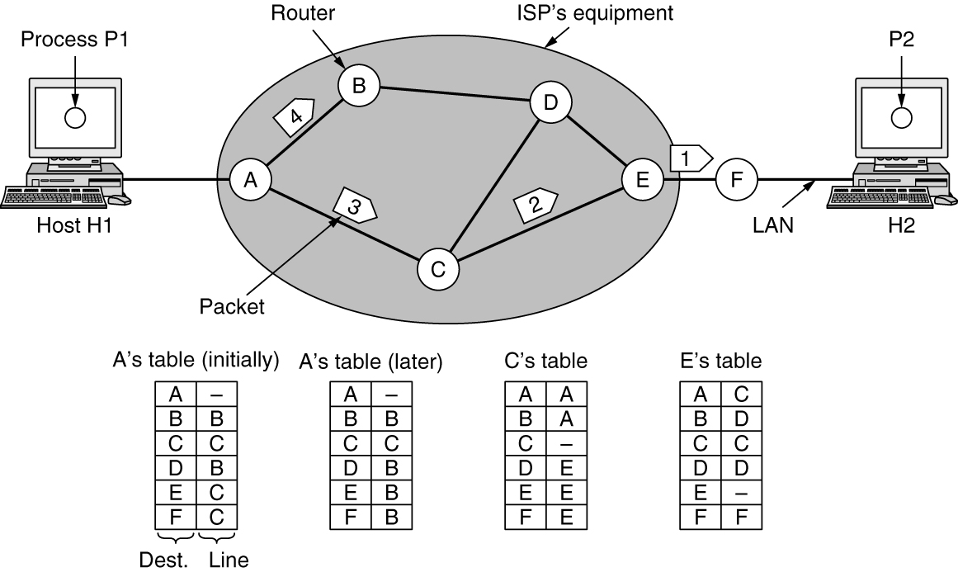
Implementation of Connectionless Service
Datagram Network
Suppose that the process P1 has a long message for P2.
It hands the message to the transport layer, with instructions to deliver it to process P2 on host H2. The transport layer code runs on H1, typically within the operating system.
Let us assume for this example that the message is four times longer than the maximum packet size, so the network layer has to break it into four packets, 1, 2, 3, and 4

Slide 8
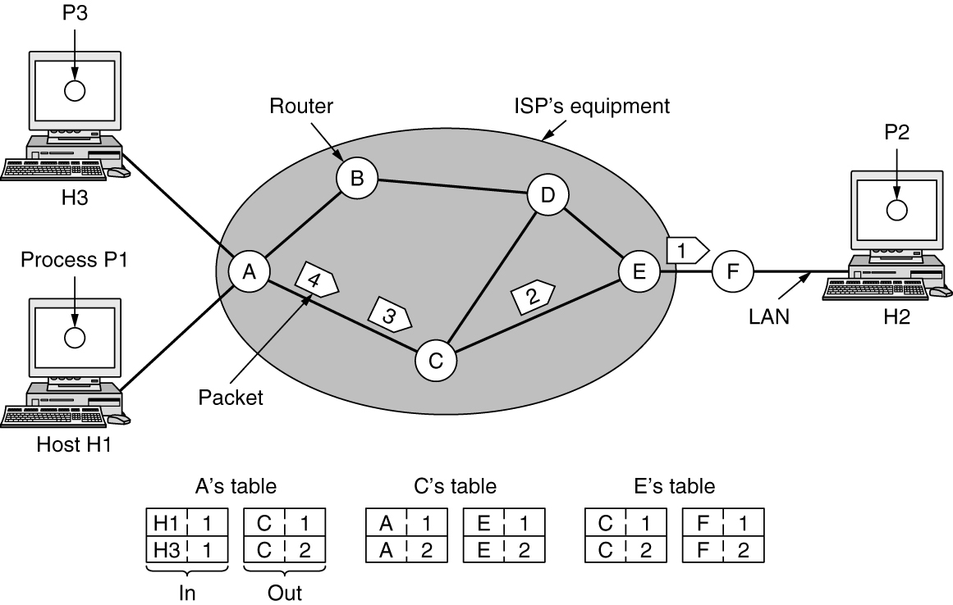
Implementation of Connection-Oriented Service
Virtual-Circuit Network
Here, host H1 has established connection 1 with host H2.
This connection is remembered as the first entry in each of the routing tables.
The first line of A’s table says that if a packet bearing connection identifier 1 comes in from H1, it is to be sent to router C and given connection identifier 1.
Similarly, the first entry at C routes the packet to E, also with connection identifier 1.

Slide 9
Question for you
What are the differences between datagram network and virtual-circuit network?

Slide 10
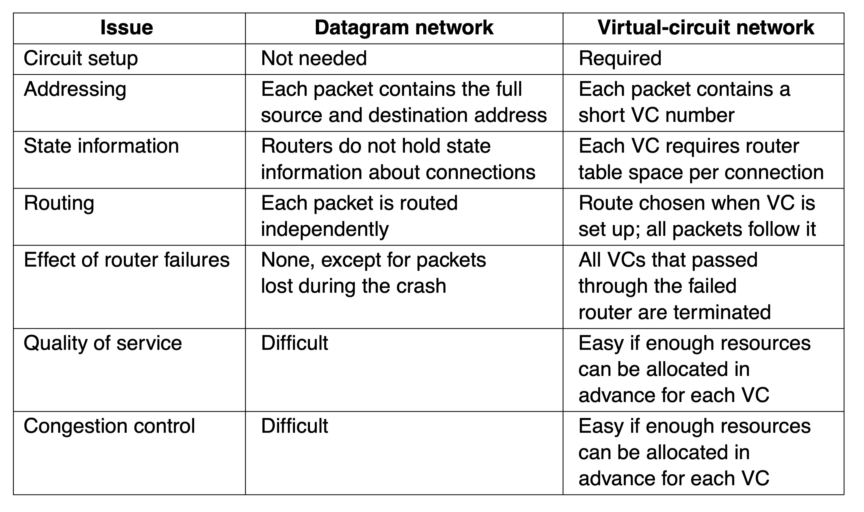
Comparison of Virtual-Circuit and Datagram Networks
Comparison of datagram and virtual-circuit networks

Slide 11
Routing Algorithms in a Single Network (1 of 3)
Optimality principle
Shortest path algorithm
Distance vector routing
Link state routing

Slide 12
Routing Algorithms in a Single Network (2 of 3)
Hierarchical routing within a network
Broadcast routing
Multicast routing
Anycast routing

Slide 13
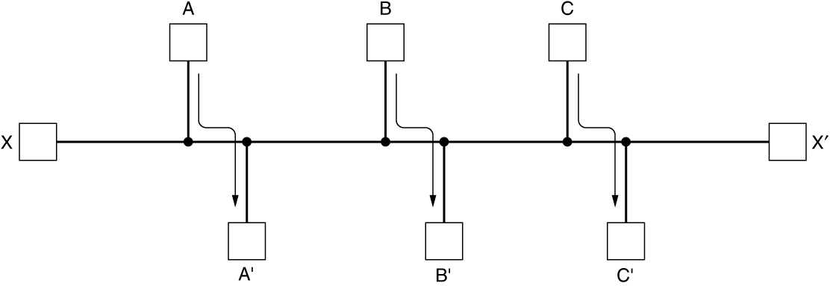
Routing Algorithms in a Single Network (3 of 3)
The routing algorithm is that part of the network layer software responsible for deciding which output line an incoming packet should be transmitted on.
Properties are desirable in a routing algorithm: correctness, simplicity, robustness, stability, fairness, and efficiency.
Nonadaptive algorithms do not base their routing decisions on any measurements or estimates of the current topology and traffic. Known as Static Routing.
Adaptive algorithms, in contrast, change their routing decisions to reflect changes in the topology, and sometimes changes in the traffic as well. Known as Dynamic Routing.
Network with a conflict between fairness and efficiency

Slide 14
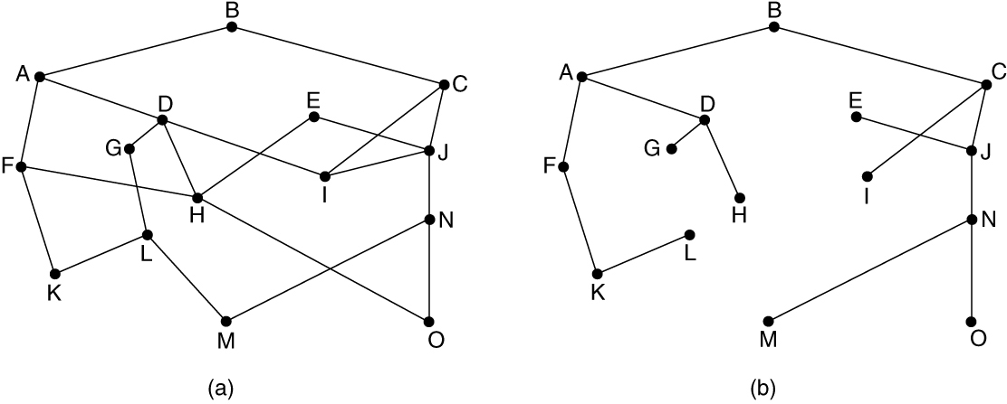
The Optimality Principle
One can make a general statement about optimal routes without regard to network topology or traffic. This statement is known as the optimality principle.
As a direct consequence of the optimality principle, the set of optimal routes from all sources to a given destination form a tree rooted at the destination. Such a tree is called a sink tree.
Note that a sink tree is not necessarily unique; other trees with the same path lengths may exist.
If we allow all of the possible paths to be chosen, the tree becomes a more general structure called a DAG (Directed Acyclic Graph).
(a) A network. (b) A sink tree for router B.

Slide 15
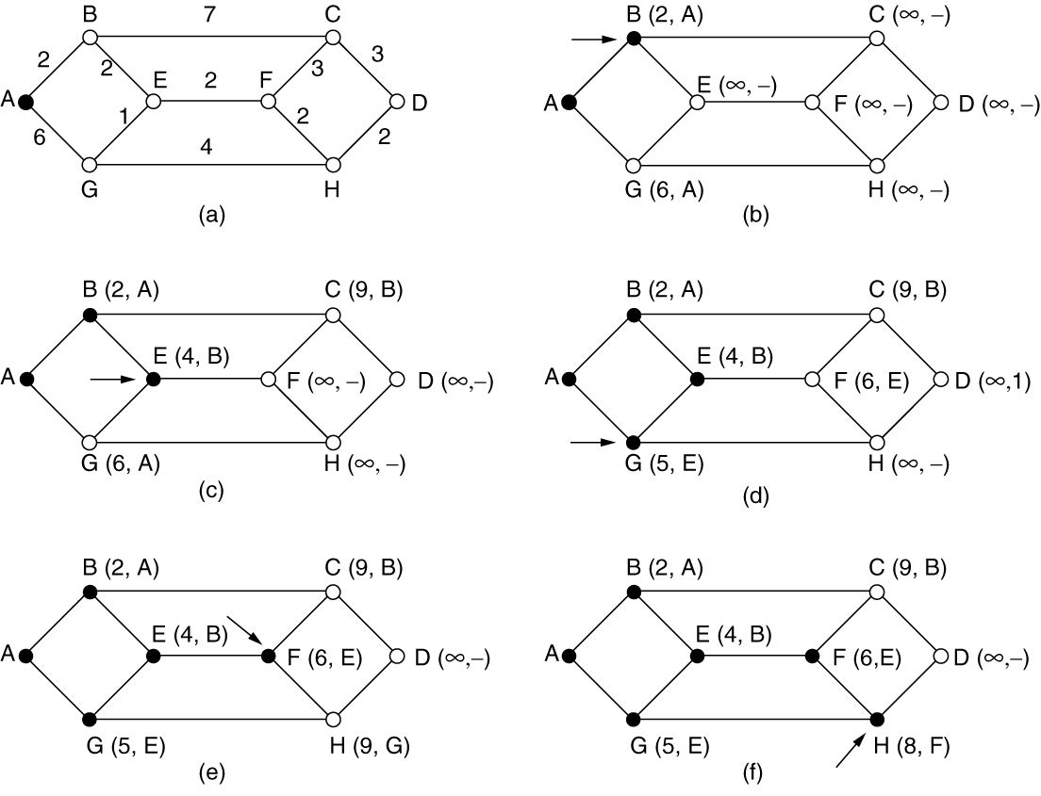
Shortest Path Algorithm (1 of 2)
The first six steps used in computing the shortest path from A to D. The arrows indicate the working node.

Slide 16
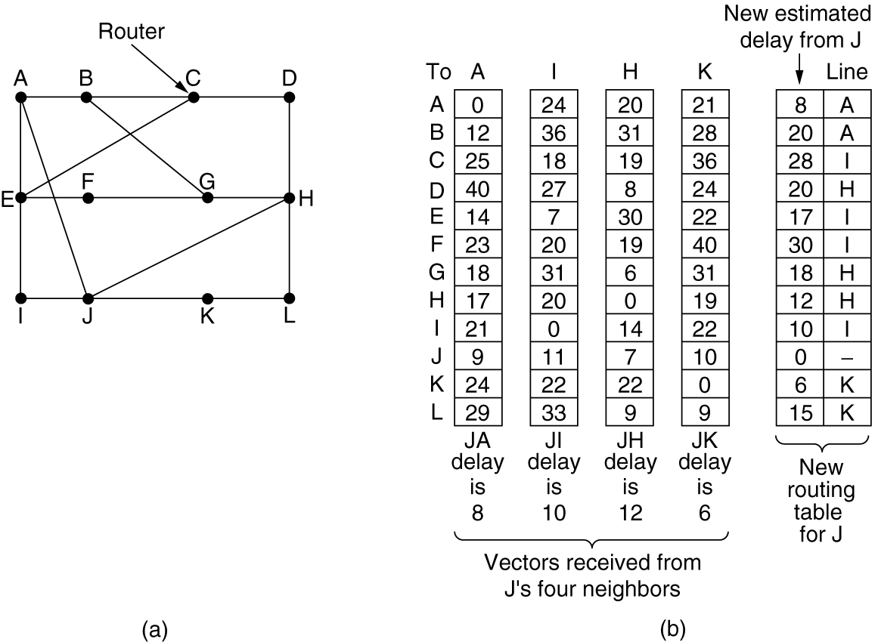
Distance Vector Routing
A distance vector routing algorithm AKA Bellman-Ford routing algorithm operates by having each router maintain a table (i.e., a vector) giving the best-known distance to each destination and which link to use to get there.
(a) A network. (b) Input from A, I, H, K, and the new routing table for J.

Slide 17
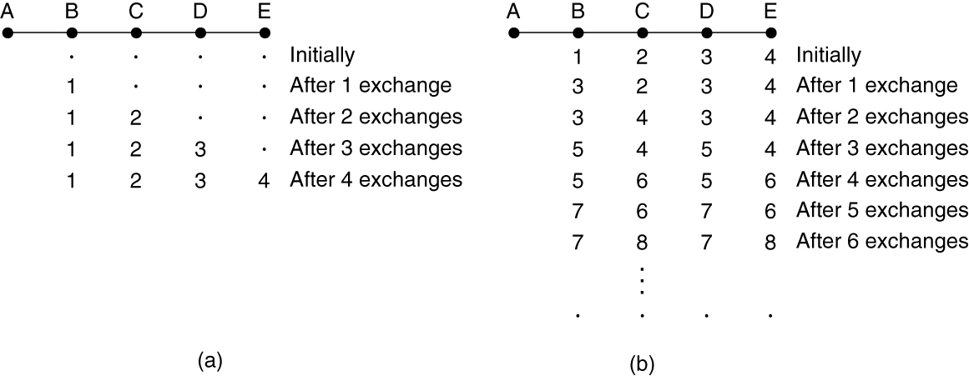
The Count-to-Infinity Problem
Routers B, C, D, and E have distances to A of 1, 2, 3, and 4 hops, respectively. Suddenly, either A goes down or the link between A and B is cut (which is effectively the same thing from B’s point of view).
The count-to-infinity problem

Slide 18
Link State Routing
Discover neighbors, learn network addresses
Set distance/cost metric to each neighbor
Construct packet telling all it has learned
Send packet to, receive packets from other routers
Compute shortest path to every other router

Slide 19
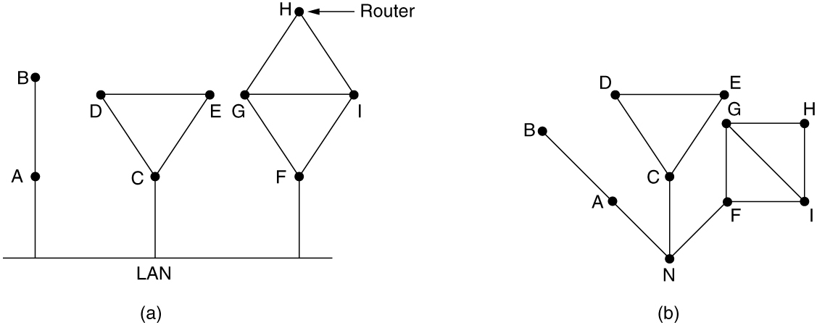
Learning about the Neighbors
(a) Nine routers and a broadcast LAN. (b) A graph model of (a).

Slide 20
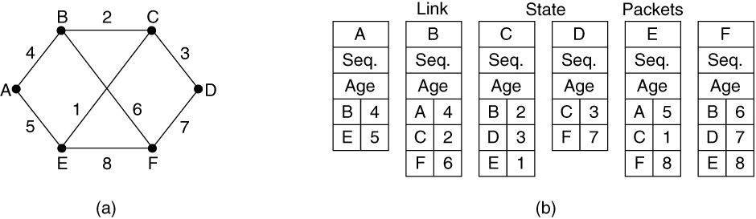
Building Link State Packets
(a) A network. (b) The link state packets for this network.

Slide 21
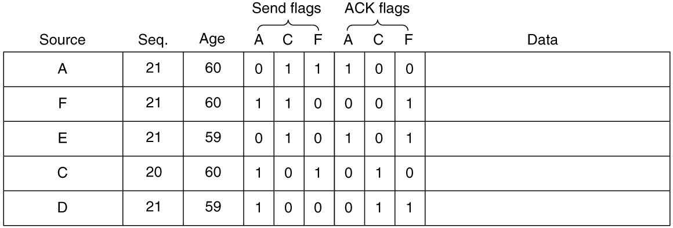
Distributing the Link State Packets
The packet buffer for router B in Fig. 5-12(a)

Slide 22
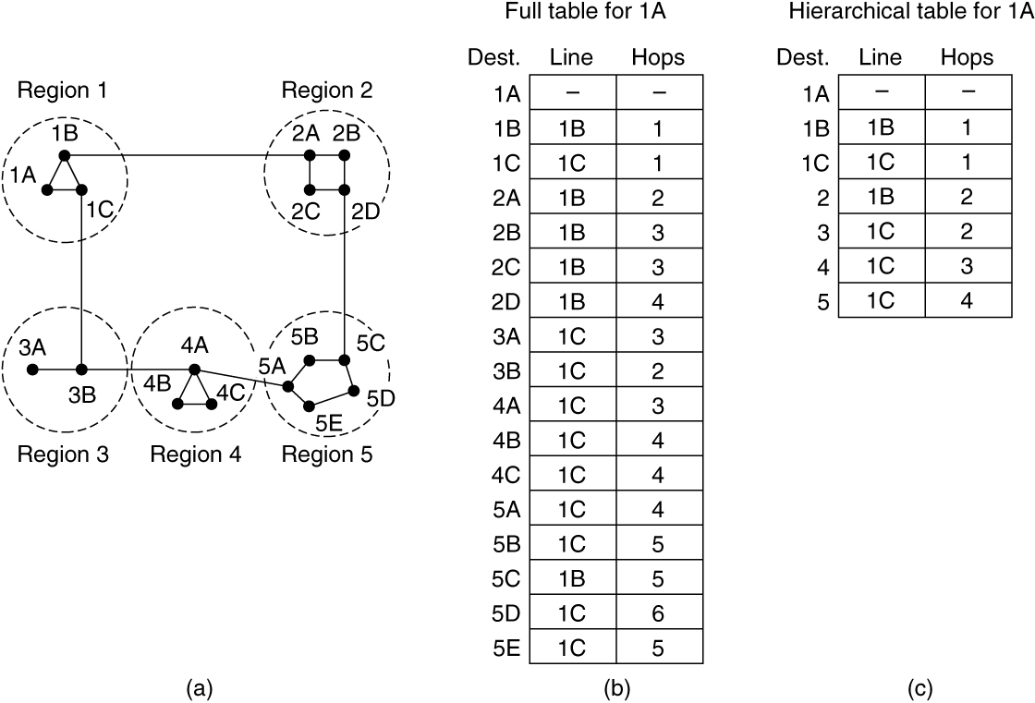
Hierarchical Routing within a Network
Hierarchical routing

Slide 23
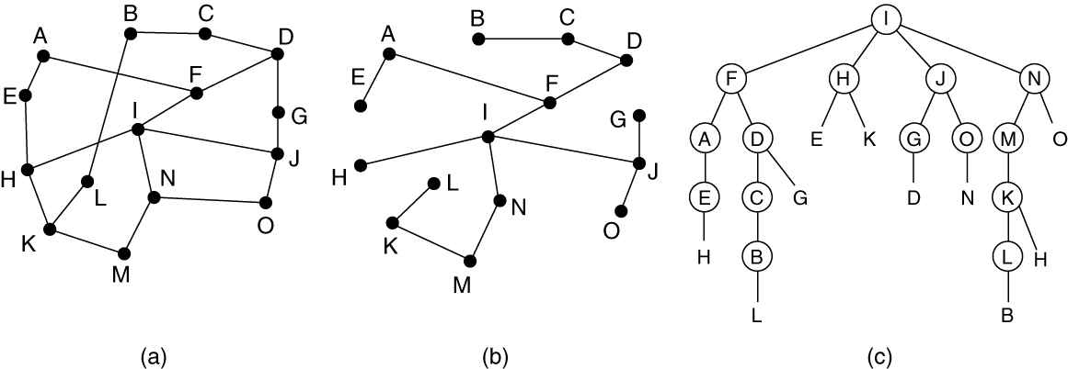
Broadcast Routing
Reverse path forwarding. (a) A network. (b) Sink tree for router I. (c) The tree built by reverse path forwarding from I.

Slide 24
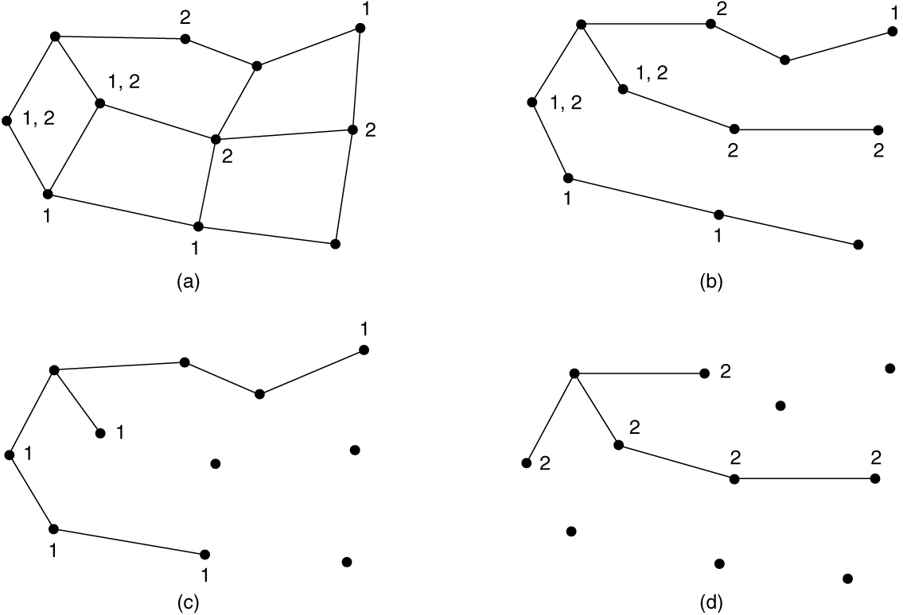
Multicast Routing (1 of 2)
(a) A network. (b) A spanning tree for the leftmost router. (c) A multicast tree for group 1. (d) A multicast tree for group 2.

Slide 25
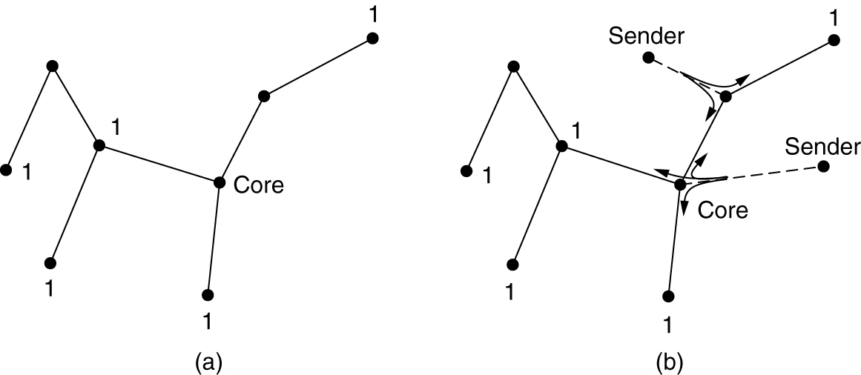
Multicast Routing (2 of 2)
(a) Core-based tree for group 1. (b) Sending to group 1.

Slide 26
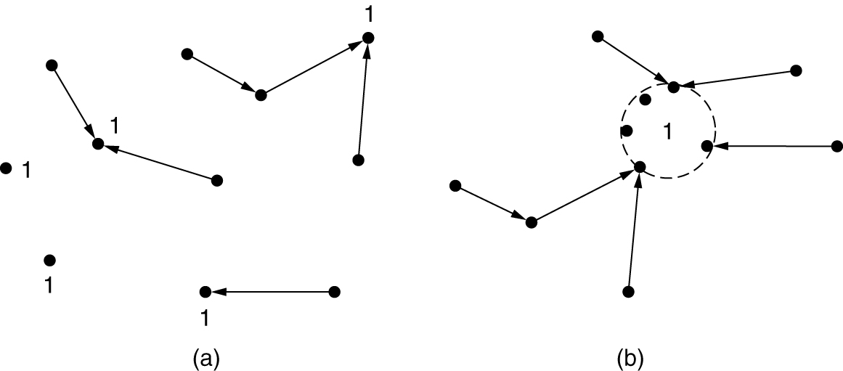
Anycast Routing
(a) Anycast routes to group 1. (b) Topology seen by the routing protocol.

Slide 27
Traffic Management at the Network Layer
The need for traffic management: congestion
Approaches to traffic management
Traffic-aware routing
Admission control
Load shedding
Traffic shaping
Active queue management
Random early detection
Choke packets
Explicit congestion notification
Hop-by-hop backpressure

Slide 28
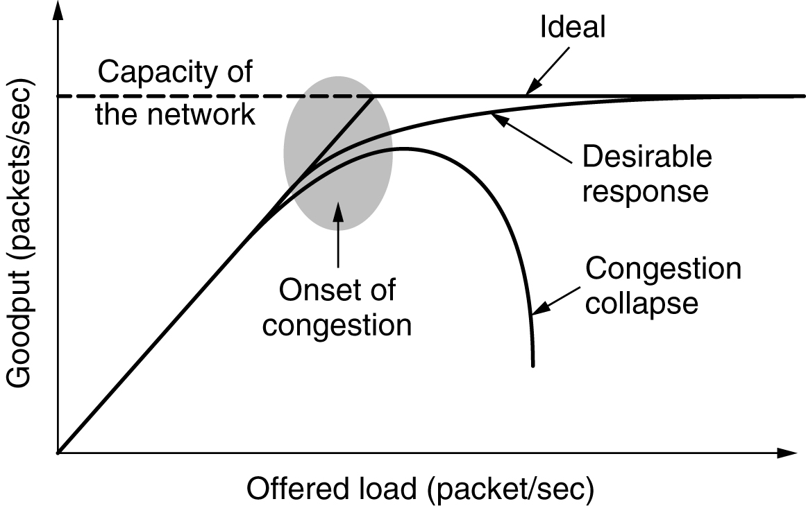
Congestion
Performance drops significantly in the presence of congestion: packet loss rates increase, and latency also increases as router queues fill with packets

Slide 29
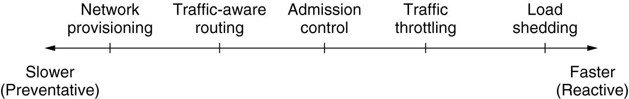
Approaches to Traffic Management
Timescales of approaches to traffic and congestion management

Slide 30
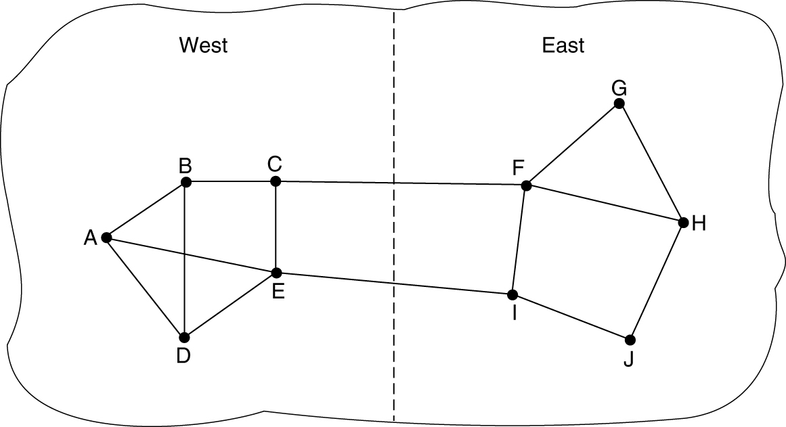
Traffic-Aware Routing
A network in which the East and West parts are connected by two links

Slide 31
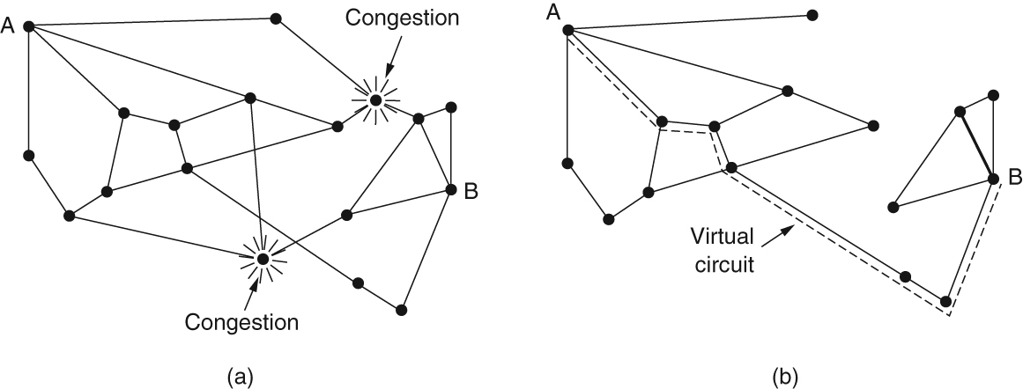
Admission Control
(a) A congested network. (b) The portion of the network that is not congested. A virtual circuit from A to B is also shown.

Slide 32
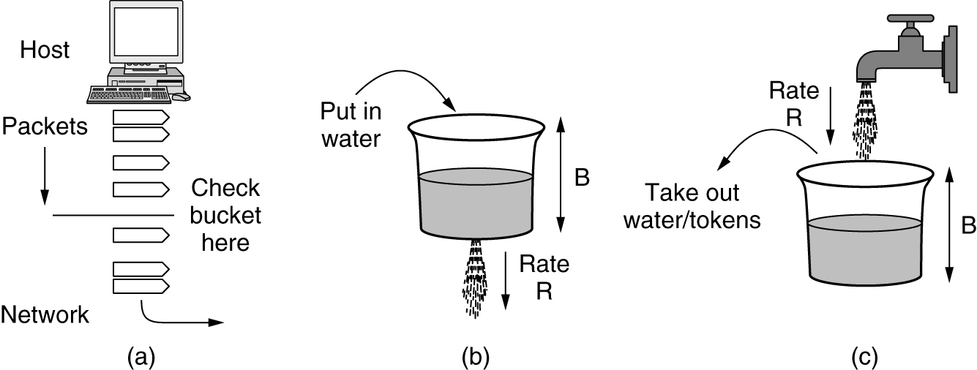
Traffic Shaping (1 of 2)
(a) Shaping packets. (b) A leaky bucket. (c) A token bucket.

Slide 33
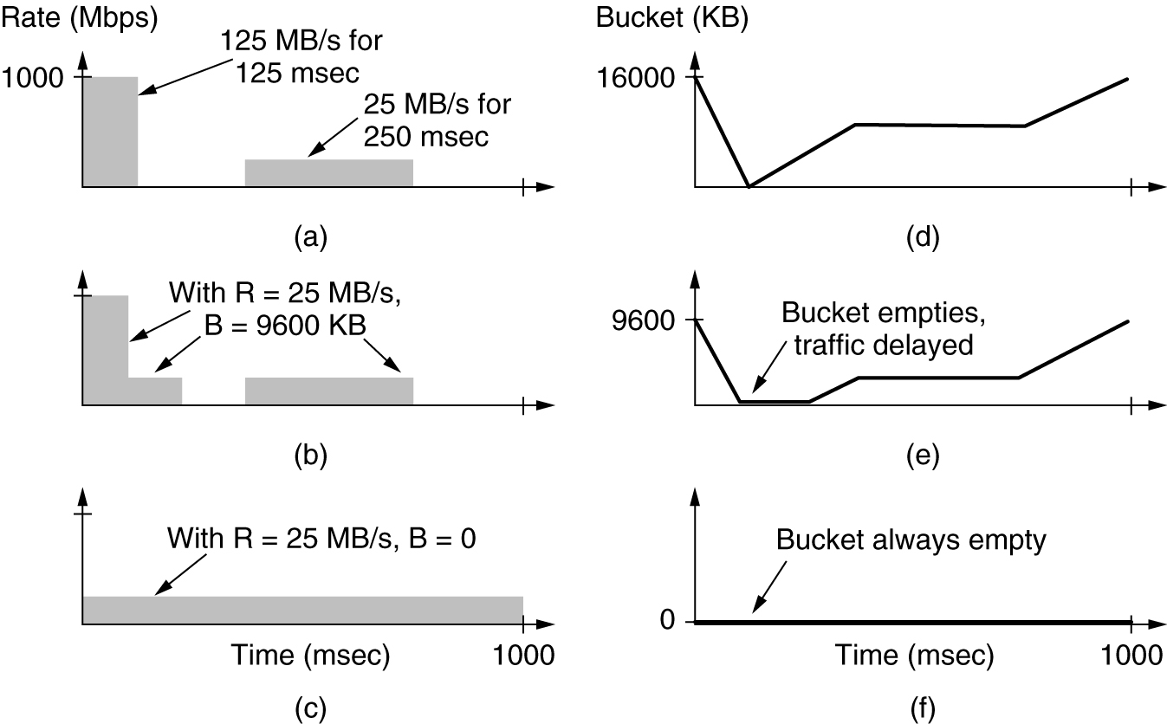
Traffic Shaping (2 of 2)
(a) Traffic from a host. Output shaped by a token bucket of rate 200 Mbps and capacity (b) 9600 KB and (c) 0 KB. Token bucket level for shaping with rate 200 Mbps and capacity (d) 16,000 KB, (e) 9600 KB, and (f) 0 KB.

Slide 34
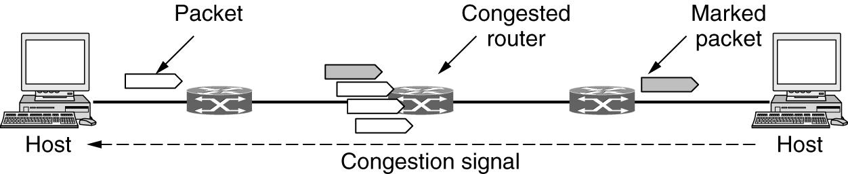
Explicit Congestion Notification
Explicit congestion notification

Slide 35
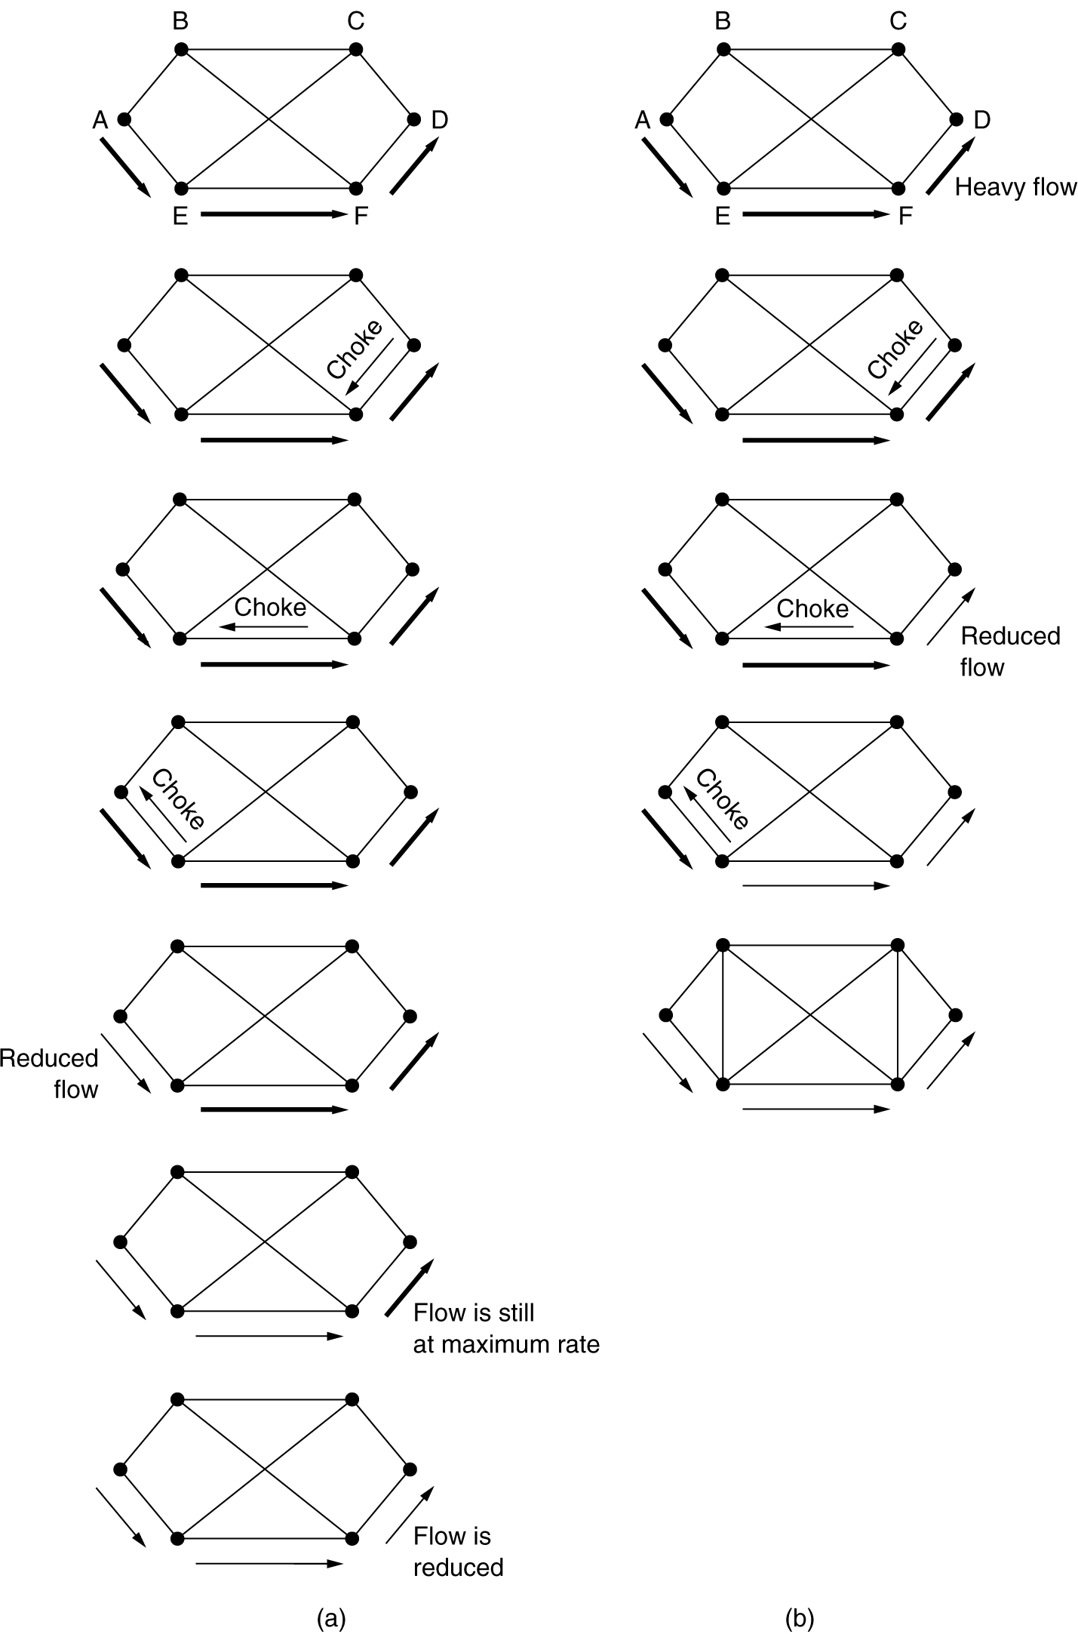
Hop-by-Hop Backpressure
(a) A choke packet that affects only the source. (b) A choke packet that affects each hop it passes through.

Slide 36
Quality of Service and Application QoE
Application QoS requirements
Overprovisioning
Packet scheduling
Integrated services
RSVP—The Resource reSerVation Protocol
Differentiated services
Expedited forwarding
Assured forwarding

Slide 37
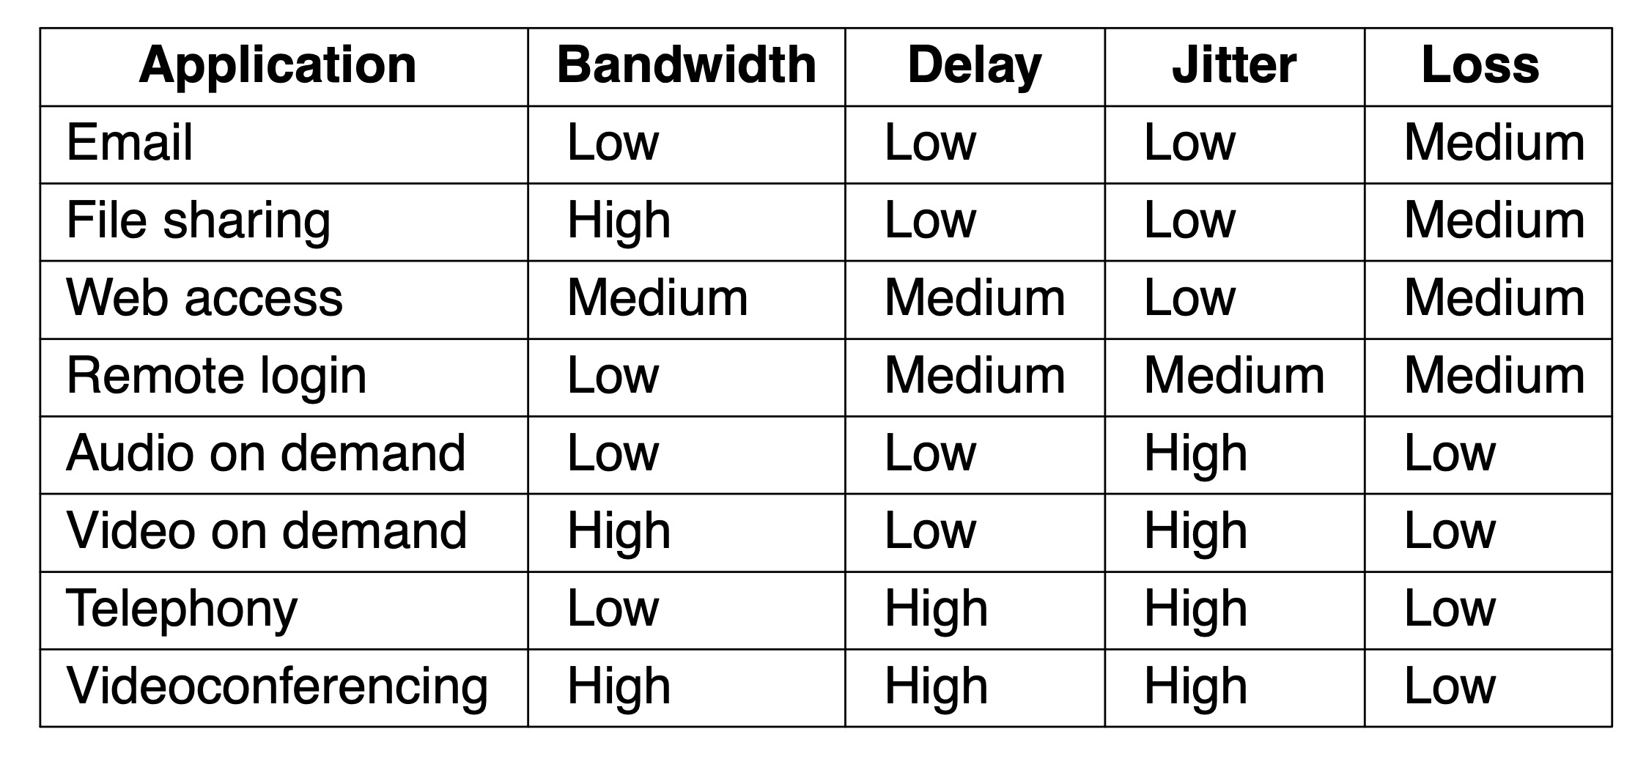
Application QoS Requirements
Stringency of applications’ quality-of-service requirements

Slide 38
Categories of QoS and Examples
Constant bit rate
Telephony
Real-time variable bit rate
Compressed videoconferencing
Non-real-time variable bit rate
Watching a movie on demand
Available bit rate
File transfer

Slide 39
Overprovisioning
Helps to provide good quality of service
Ensure the network has the capacity for all traffic
Expensive solution
Network issues to address for quality of service
Addressing applications needs
Regulating traffic entering the network
Reserving resources at routers to guarantee performance
Safely accepting more traffic

Slide 40
Packet Scheduling
Router resources reserved for different flows
Bandwidth
Buffer space
CPU cycles
Algorithms
First-In First-Out (FIFO) scheduling
Fair queueing
Weighted fair queueing
Putting it together

Slide 41
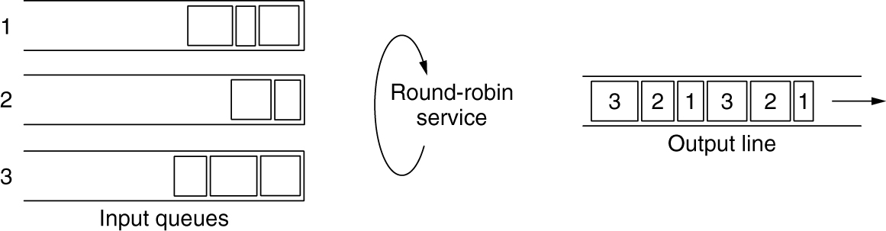
Fair Queueing (1 of 2)
Round-robin fair queueing

Slide 42
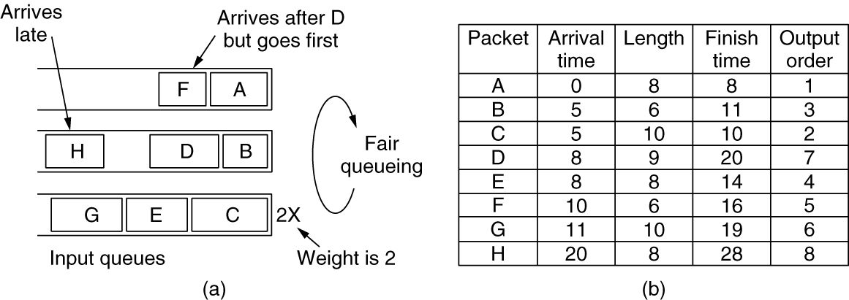
Fair Queueing (2 of 2)
(a) Weighted Fair Queueing. (b) Finishing times for the packets.

Slide 43
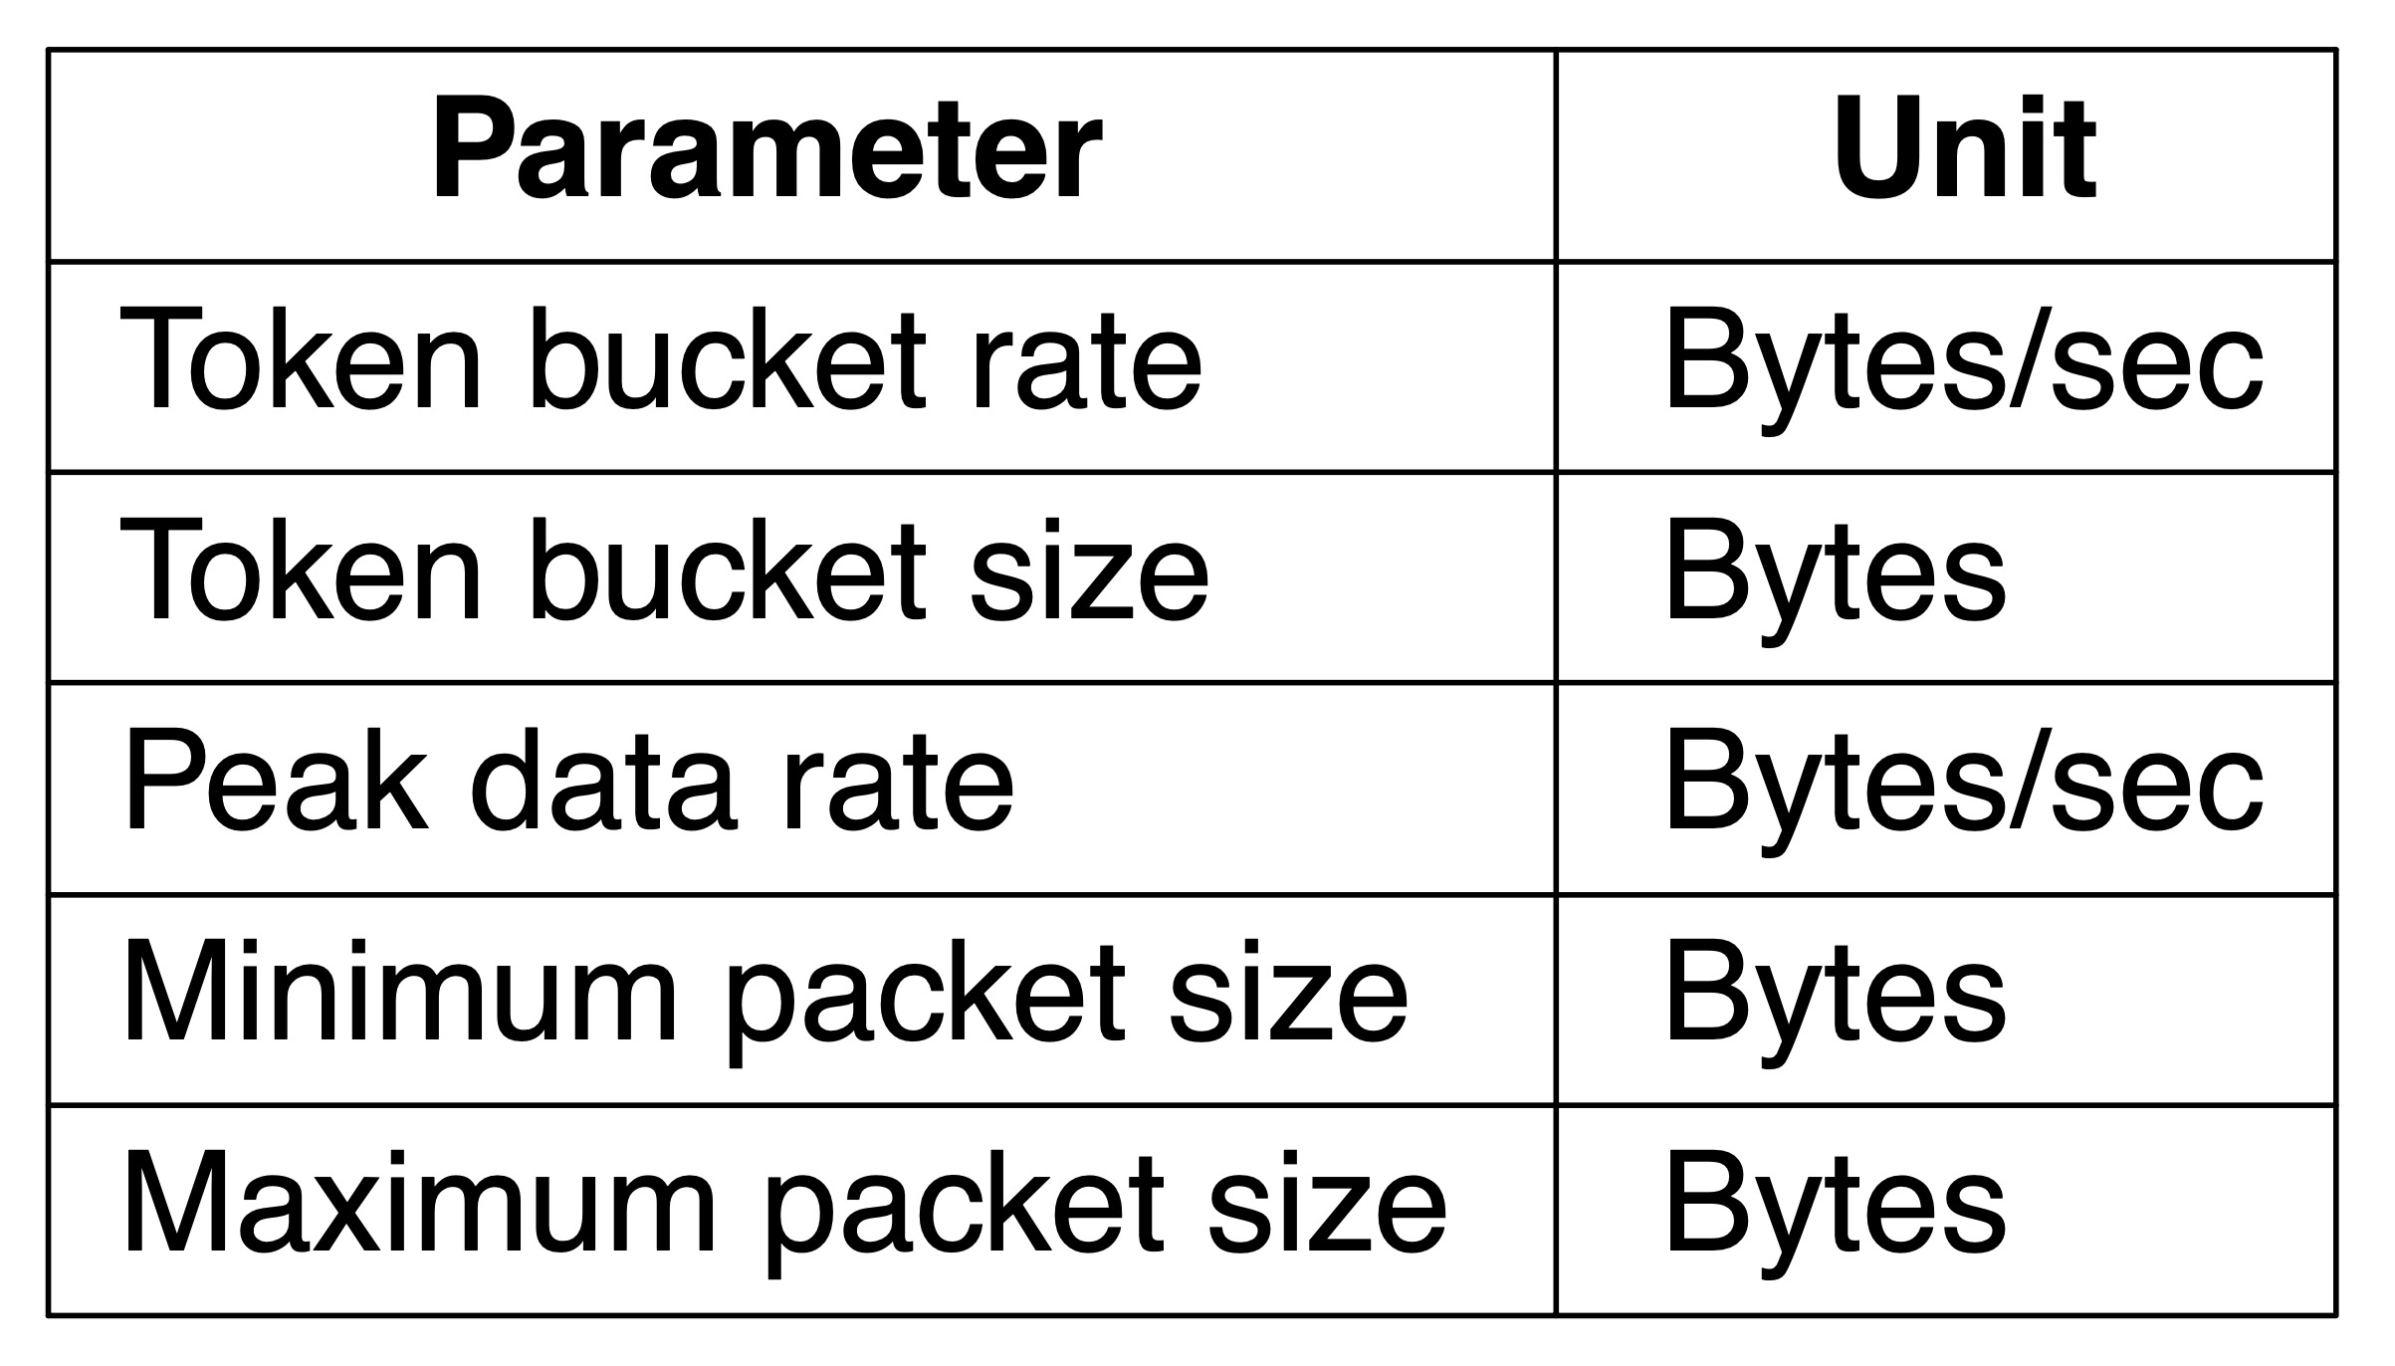
Putting it Together (1 of 2)
An example flow specification

Slide 44
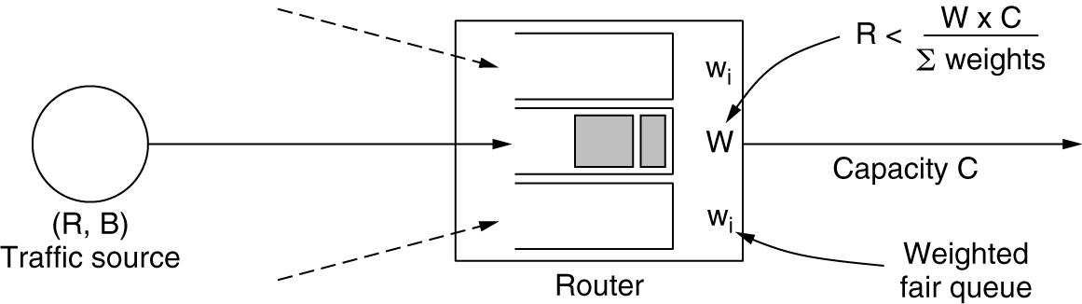
Putting it Together (2 of 2)
Bandwidth and delay guarantees with token buckets and WFQ

Slide 45
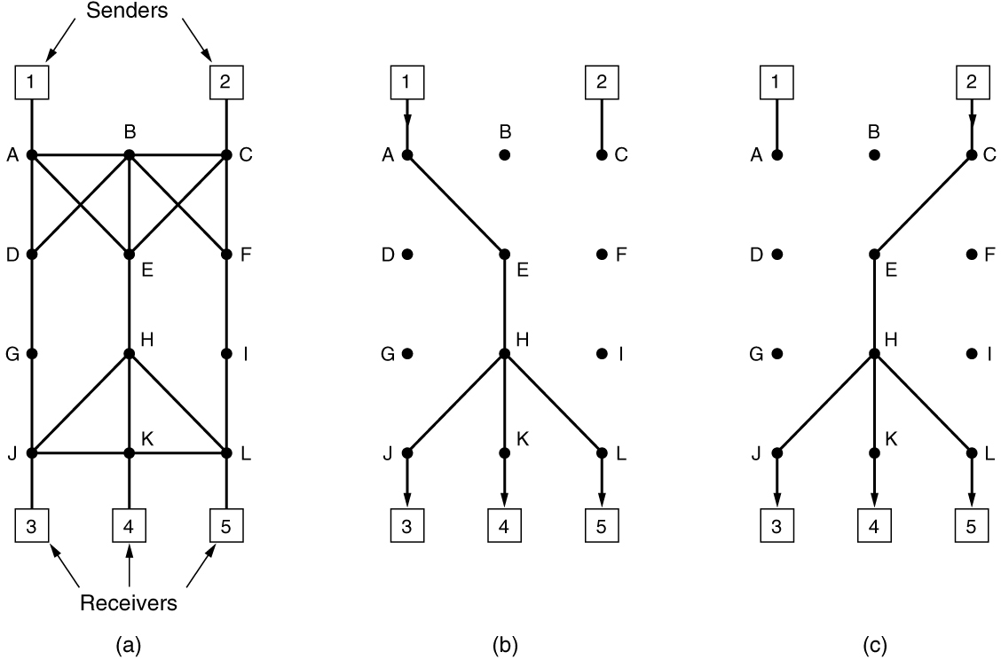
Integrated Services (1 of 2)
(a) A network. (b) The multicast spanning tree for host 1. (c) The multicast spanning tree for host 2.

Slide 46
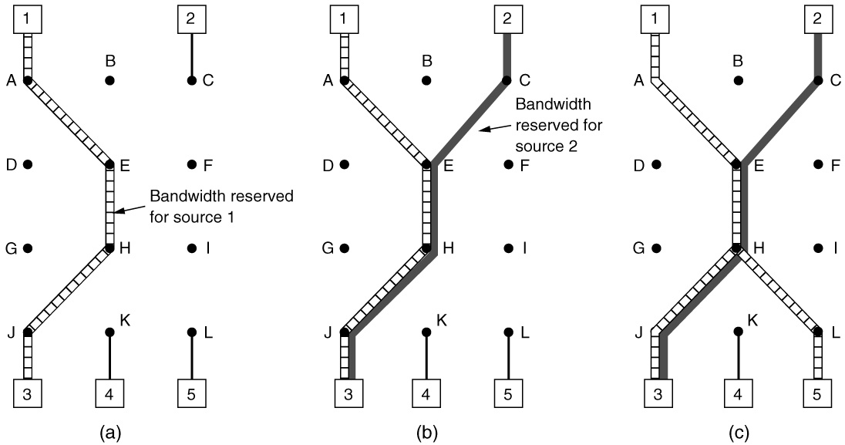
Integrated Services (2 of 2)
(a) Host 3 requests a channel to host 1. (b) Host 3 then requests a second channel, to host 2. (c) Host 5 requests a channel to host 1.

Slide 47
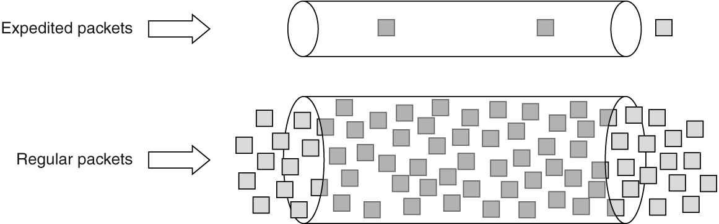
Differentiated Services (1 of 2)
Expedited packets experience a traffic-free network

Slide 48
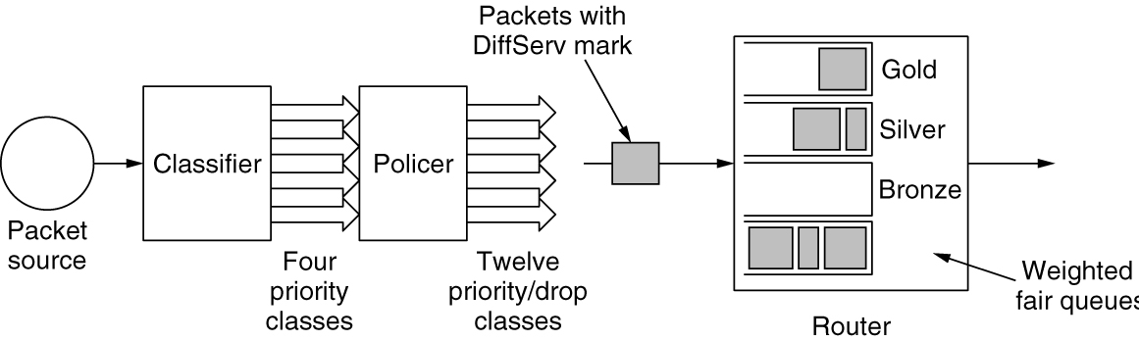
Differentiated Services (2 of 2)
A possible implementation of assured forwarding

Slide 49
Internetworking
Internetworks: an overview
How networks differ
Connecting heterogeneous networks
Connecting endpoints across heterogeneous networks
Internetwork routing: routing across multiple networks
Supporting different packet sizes: packet fragmentation

Slide 50
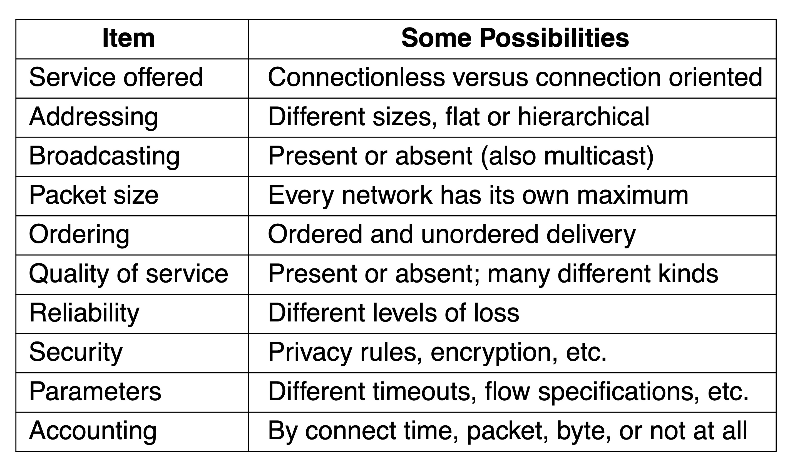
How Networks Differ
Some of the many ways networks can differ

Slide 51
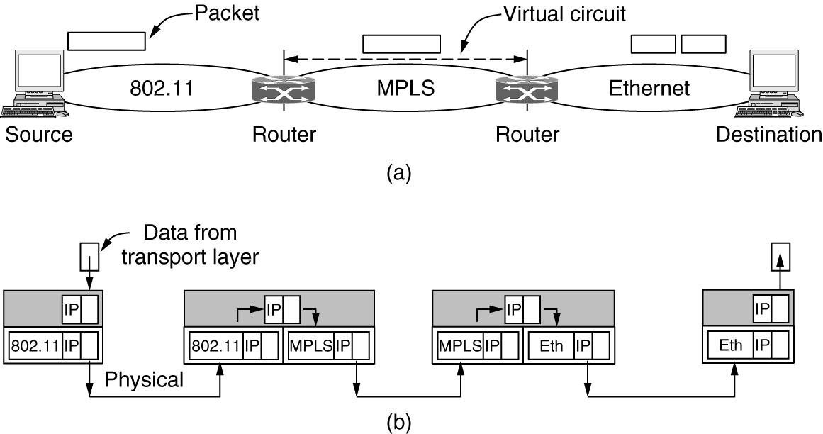
Connecting Heterogeneous Networks
(a) A packet crossing different networks. (b) Network and link layer protocol processing.

Slide 52
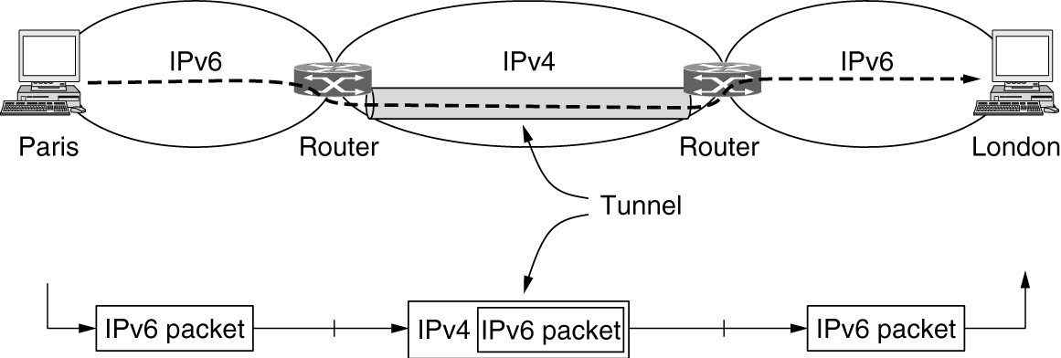
Connecting Endpoints Across Heterogeneous Networks (1 of 2)
Tunneling a packet from Paris to London

Slide 53
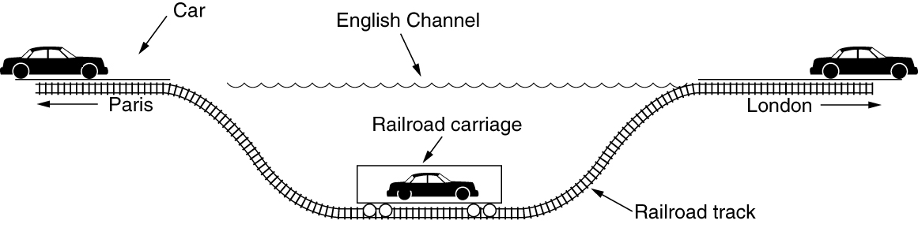
Connecting Endpoints Across Heterogeneous Networks (2 of 2)
Tunneling a car from France to England

Slide 54
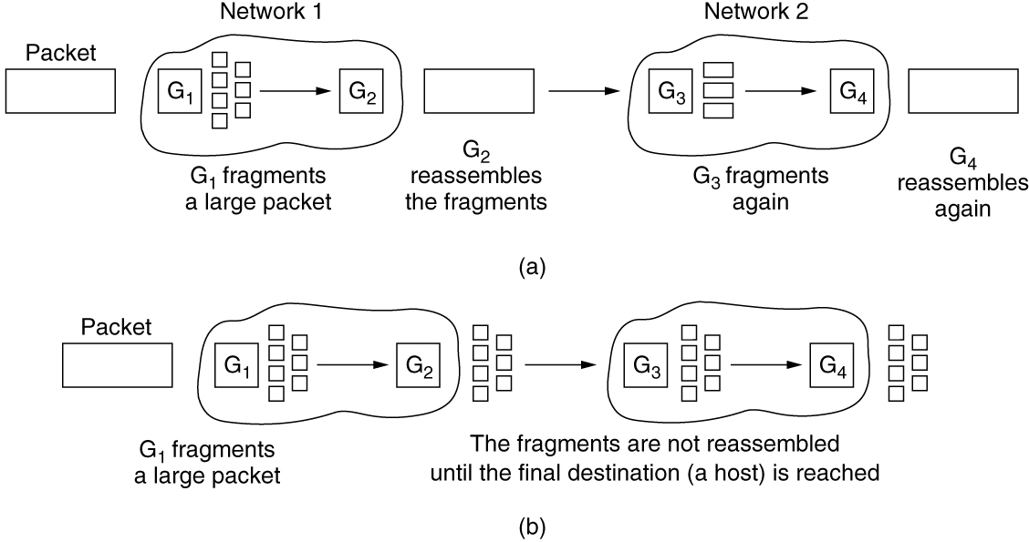
Supporting Different Packet Sizes: Packet Fragmentation (1 of 3)
(a) Transparent fragmentation. (b) Nontransparent fragmentation.

Slide 55
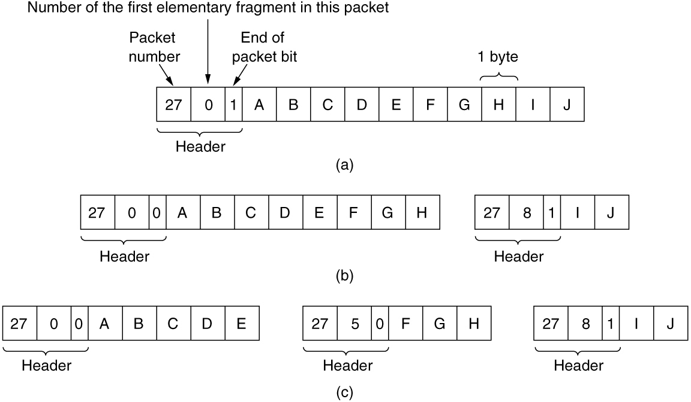
Supporting Different Packet Sizes: Packet Fragmentation (2 of 3)
Fragmentation when the elementary data size is 1 byte. (a) Original packet, containing 10 data bytes. (b) Fragments after passing through a network with maximum packet size of 8 payload bytes plus header. (c) Fragments after passing through a size 5 gateway.

Slide 56
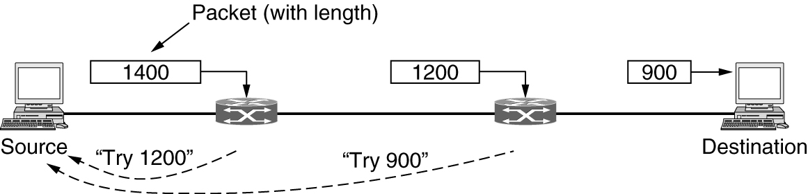
Supporting Different Packet Sizes: Packet Fragmentation (3 of 3)
Path MTU discovery

Slide 57
Software-Defined Networking
Overview
The SDN control plane: logically centralized software control
The SDN data plane: programmable hardware
Programmable network telemetry

Slide 58
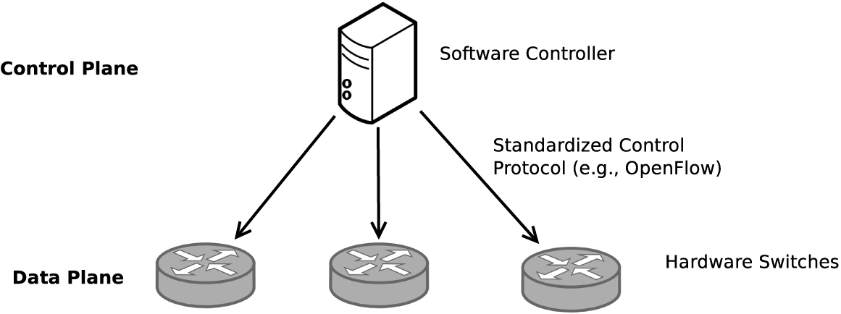
Overview
Control and data plane separation in SDN

Slide 59
The SDN Data Plane: Programmable Hardware (1 of 2)
Reconfigurable match-action pipeline for a programmable data plane

Slide 60
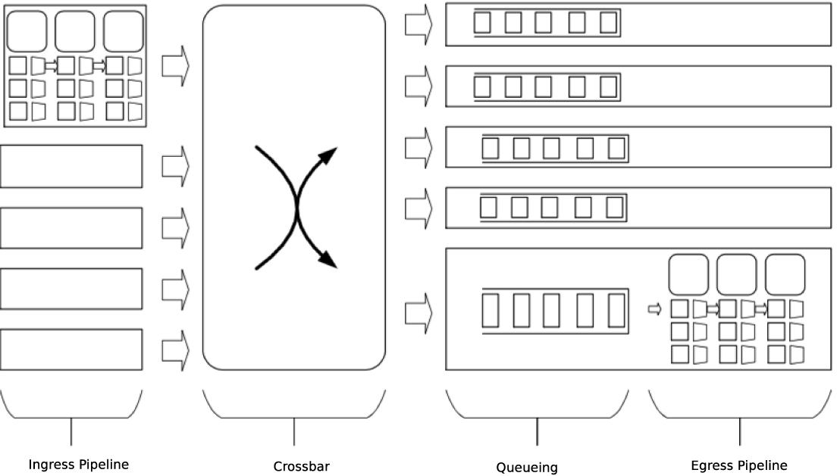
The SDN Data Plane: Programmable Hardware (2 of 2)
Reconfigurable match-action pipelines on both ingress and egress

Slide 61
The Network Layer in the Internet (1 of 3)
Top 10 principles
Make sure it works
Keep it simple
Make clear choices
Exploit modularity
Expect heterogeneity
Avoid static options and parameters
Look for a good design; it need not be perfect
Be strict when sending and tolerant when receiving
Think about scalability
Consider performance and cost

Slide 62
The Network Layer in the Internet (2 of 3)
The IP Version 4 Protocol
IP Addresses
IP Version 6
Internet control protocols
Label switching and MPLS
OSPF—An interior gateway routing protocol
BGP—The exterior gateway routing protocol
Internet multicasting

Slide 63
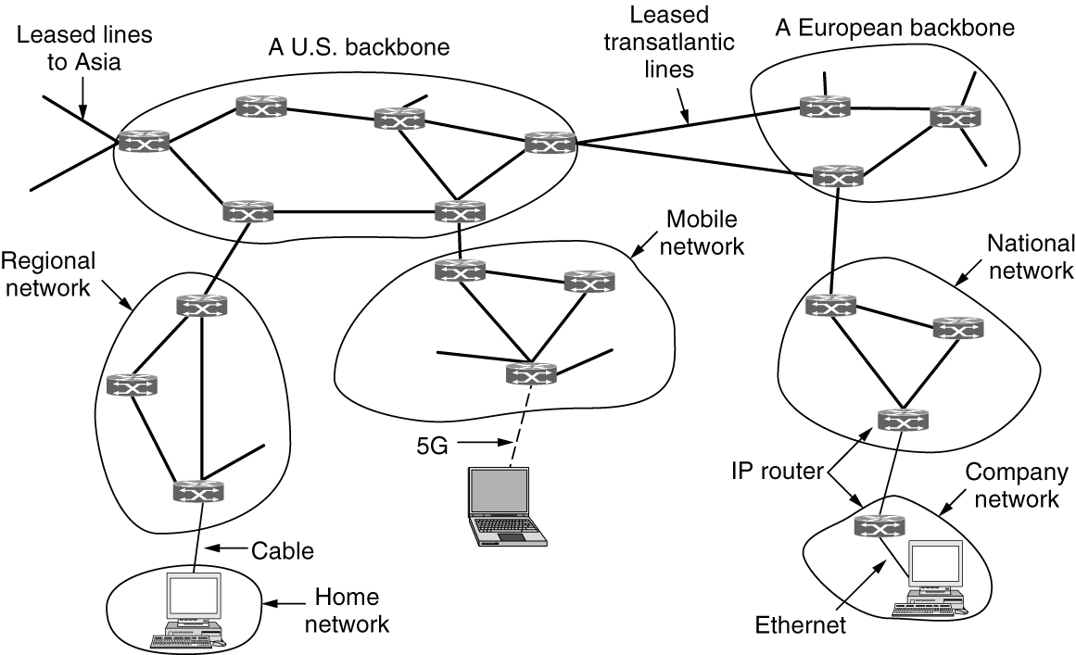
The Network Layer in the Internet (3 of 3)
The Internet is an interconnected collection of many networks.

Slide 64
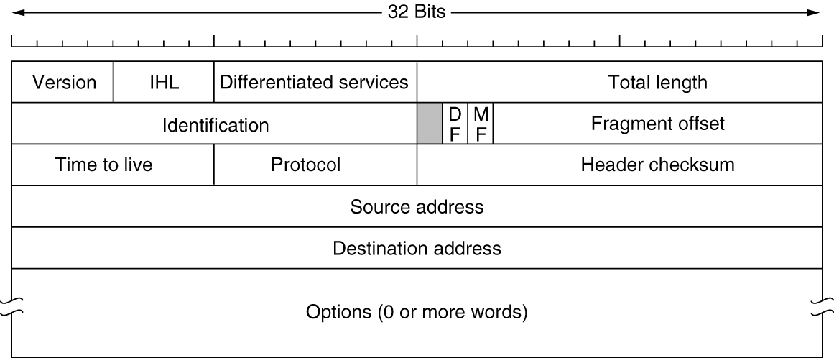
The IP Version 4 Protocol (1 of 2)
The IPv4 (Internet Protocol version 4) header

Slide 65
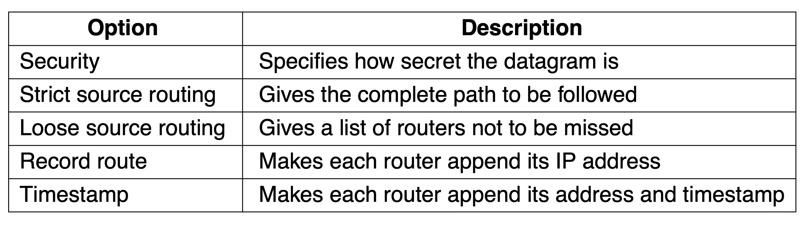
The IP Version 4 Protocol (2 of 2)
Some of the IP options

Slide 66
IP Addresses
Prefixes
A contiguous block of IP address space
Subnets
CIDR—Classless InterDomain Routing
Classful and special addressing
NAT—Network Address Translation

Slide 67
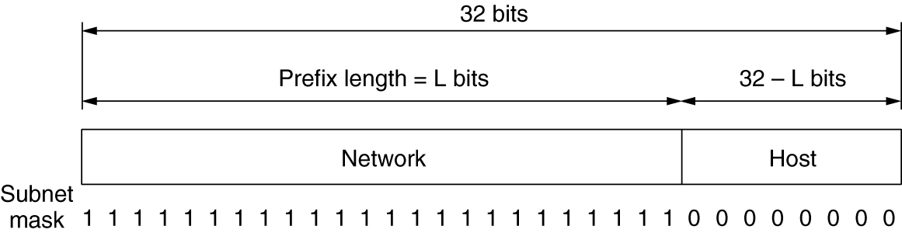
Prefixes
A prefix and a subnet mask

Slide 68
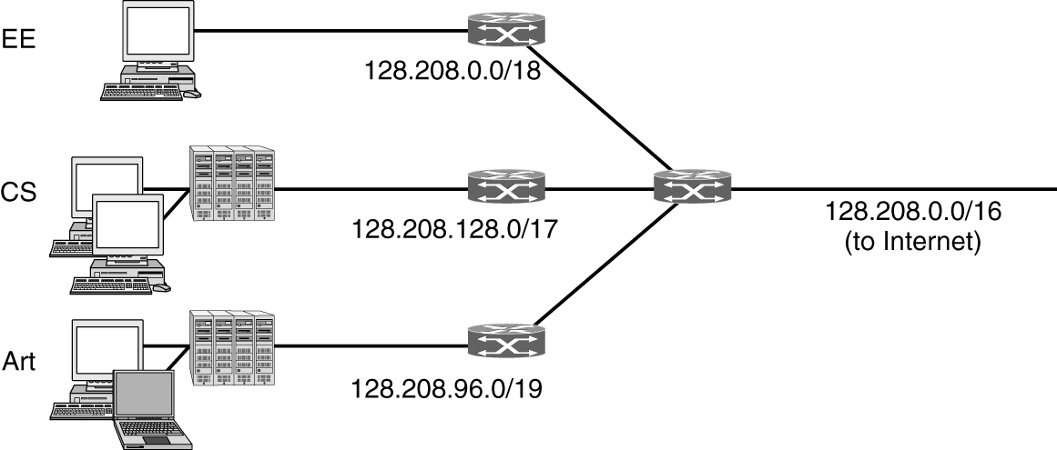
Subnets
Splitting an IP prefix into separate networks with subnetting

Slide 69
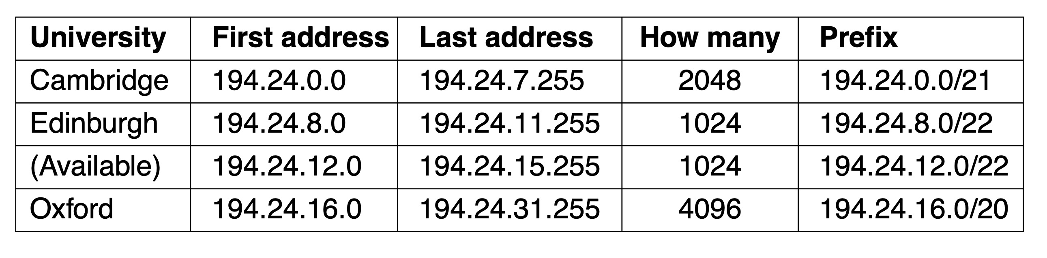
CIDR—Classless InterDomain Routing (1 of 3)
A set of IP address assignments

Slide 70

CIDR—Classless InterDomain Routing (2 of 3)
Aggregation of IP prefixes

Slide 71

CIDR—Classless InterDomain Routing (3 of 3)
Longest matching prefix routing at the New York router

Slide 72

Classful and Special Addressing (1 of 2)
IP address formats

Slide 73

Classful and Special Addressing (2 of 2)
Special IP addresses

Slide 74

NAT—Network Address Translation
Placement and operation of a NAT box

Slide 75
IP Version 6 (1 of 3)
The main IPv6 header
Extension headers
Controversies

Slide 76
IP Version 6 (2 of 3)
IPv6 major goals
Support billions of hosts
Reduce routing table size
Simplify the protocol
Provide better security
Attention to type of service
Aid multicasting
Roaming host without changing address
Allow future protocol evolution
Permit coexistence of old and new protocols for years

Slide 77
IP Version 6 (3 of 3)
IP version 6 improvements
Longer addresses than IPv4
Simplification of the header
Better support for options
Big advance is in security
Quality of service

Slide 78

The Main IPv6 Header
The IPv6 fixed header (required)

Slide 79

Extension Headers (1 of 3)
IPv6 extension headers

Slide 80

Extension Headers (2 of 3)
The hop-by-hop extension header for large datagrams (jumbograms)

Slide 81

Extension Headers (3 of 3)
The extension header for routing

Slide 82
Internet Control Protocols
ICMP—The Internet Control Message Protocol
ARP—The Address Resolution Protocol
DHCP—The Dynamic Host Configuration Protocol

Slide 83

ICMP—The Internet Control Message Protocol
The principal ICMP message types

Slide 84

ARP—The Address Resolution Protocol
Two switched Ethernet LANs joined by a router

Slide 85
Label Switching and MPLS (1 of 3)
MPLS (MultiProtocol Label Switching)
Perilously close to circuit switching
Adds a label in front of each packet
Forwards based on the label (not the destination address)
Forwarding can be done very quickly
New MPLS header is added in front of the IP header

Slide 86

Label Switching and MPLS (2 of 3)
Transmitting a TCP segment using IP, MPLS, and PPP

Slide 87

Label Switching and MPLS (3 of 3)
Forwarding an IP packet through an MPLS network

Slide 88
OSPF—An Interior Gateway Routing Protocol (1 of 5)
Intradomain routing
IGP (Interior Gateway Protocol)
RIP (Routing Information Protocol)
Works well in small systems
OSPF (Open Shortest Path First)
Widely used in company networks
IS-IS (Intermediate-System to Intermediate-System)
Widely used in ISP networks

Slide 89
OSPF—An Interior Gateway Routing Protocol (2 of 5)
OSPF
Published in the open literature
Supports a variety of distance metrics
Dynamic
Supports routing based on type of service
Performs load balancing, splitting the load over multiple lines
Supports hierarchical systems
Provides security
Provision for dealing with routers that were connected to the Internet via a tunnel
OSPF supports multiaccess networks

Slide 90

OSPF—An Interior Gateway Routing Protocol (3 of 5)
(a) An autonomous system. (b) A graph representation of (a).

Slide 91

OSPF—An Interior Gateway Routing Protocol (4 of 5)
The relation between ASes, backbones, and areas in OSPF

Slide 92

OSPF—An Interior Gateway Routing Protocol (5 of 5)
The five types of OSPF messages

Slide 93
BGP—The Exterior Gateway Routing Protocol (1 of 3)
Possible routing constraints
Do not carry commercial traffic on the educational network
Never send traffic from the Pentagon on a route through Iraq
Use TeliaSonera instead of Verizon because it is cheaper
Don’t use AT&T in Australia because performance is poor
Traffic starting or ending at Apple should not transit Google

Slide 94

BGP—The Exterior Gateway Routing Protocol (2 of 3)
Routing policies between four autonomous systems

Slide 95

BGP—The Exterior Gateway Routing Protocol (3 of 3)
Propagation of BGP route advertisements

Slide 96
Interdomain Traffic Engineering
Tune parameters and configuration network protocols to manage utilization and congestion
Inbound traffic engineering
Selects routes to control how traffic enters the network
Set the local preference attribute for individual routes
Use AS path prepending
Leverage longest prefix match
Split a prefix into multiple smaller (longer) prefixes, so that upstream routers prefer the routes with longer prefixes
Outbound traffic engineering
How traffic leaves the network

Slide 97
Internet Multicasting
Internet multicasting
One-to-many communication using class D IP addresses
Each class D address identifies a group of hosts
Twenty-eight bits available for identifying groups
Over 250 million groups can exist at the same time
Process sends a packet to a class D address
Best-effort attempt is made to deliver it to all the members of the group addressed, but no guarantees are given

Slide 98
Policy at the Network Layer
Peering disputes
A breakdown in negotiations over paying for transit
Traffic prioritization
Generally agreed upon bright-line rules
No blocking
No throttling
No paid prioritization
Disclosure of any prioritization practices

Slide 99

Copyright
This work is protected by United States copyright laws and is provided solely for the use of instructors in teaching their courses and assessing student learning. Dissemination or sale of any part of this work (including on the World Wide Web) will destroy the integrity of the work and is not permitted. The work and materials from it should never be made available to students except by instructors using the accompanying text in their classes. All recipients of this work are expected to abide by these restrictions and to honor the intended pedagogical purposes and the needs of other instructors who rely on these materials.

